Slide 1
Linear Regression
What is Linear Regression?

Slide 2
Outline
Definition and Generic Model Statement
Deterministic Example
Stochastic Example

Slide 3
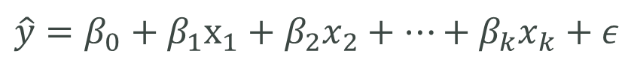
Definition and Generic Model Statement
Linear Regression: is a method of creating a linear equation to model the relationship between a dependent variable and one or more independent variables.
Generic Model Statement:
$$\hat{y}=β_{0}+β_{1}x_{1}+β_{2}x_{2}+…+β_{k}x_{k}+ε$$
Error
Dependent Variable
Regression
Coefficients
Independent variables

Slide 4
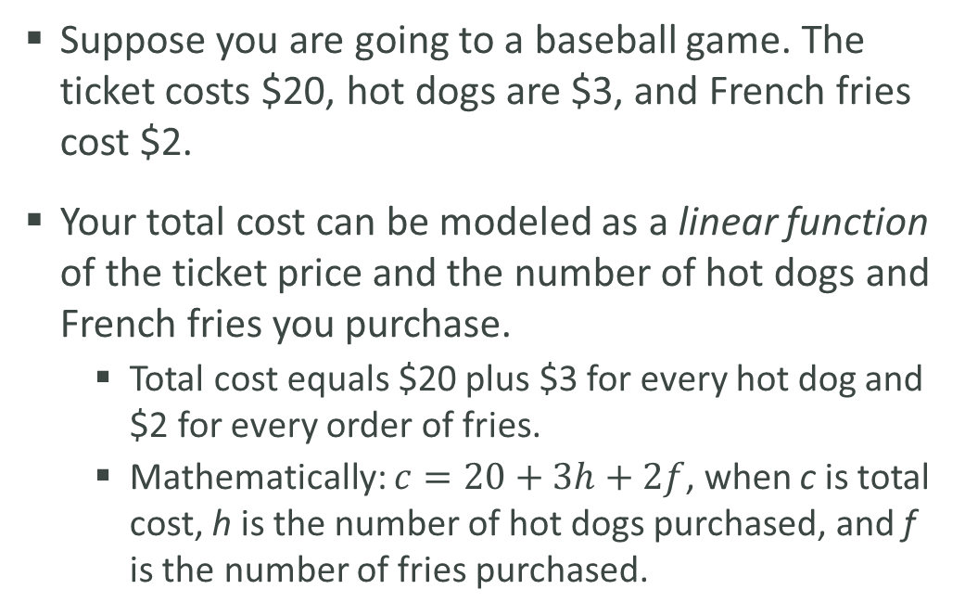
Deterministic Example
Suppose you are going to a baseball game. The ticket costs $20, hot dogs are $3, and French fries cost $2.
Your total cost can be modeled as a linear function of the ticket price and the number of hot dogs and French fries you purchase.
Total cost equals $20 plus $3 for every hot dog and $2 for every order of fries.
Mathematically: $c=20+3h+2f$, when c is total cost, h is the number of hot dogs purchased, and f is the number of fries purchased.
Hot Dogs | French Fries | Total Cost
0 | 2 | $24
2 | 2 | $30
5 | 3 | $41

Slide 5
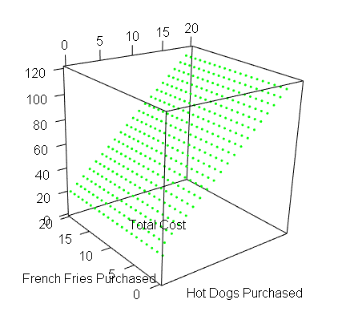

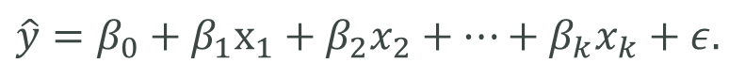
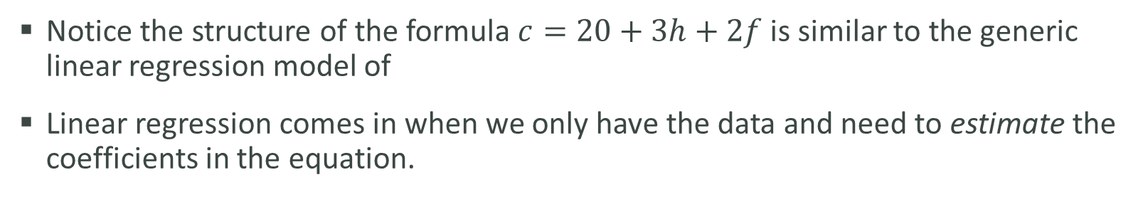
Deterministic Example
Notice the structure of the formula $c=20+3h+2f$ is similar to the generic linear regression model of
Linear regression comes in when we only have the data and need to estimate the coefficients in the equation.
$$\hat{y}=β_{0}+β_{1}x_{1}+β_{2}x_{2}+…+β_{k}x_{k}+ε.$$

Slide 6
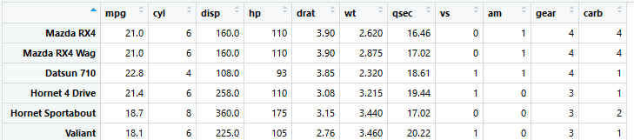
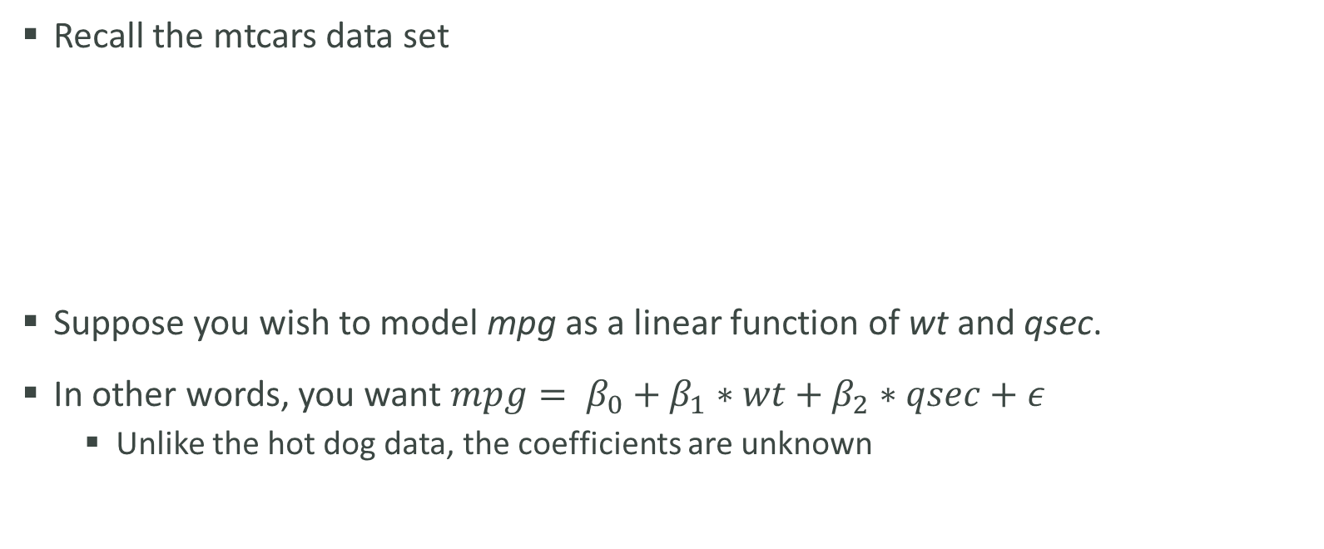
Stochastic Example
Recall the mtcars data set
Suppose you wish to model mpg as a linear function of wt and qsec.
In other words, you want $mpg= β_{0}+β_{1}∗wt+β_{2}∗qsec+ε$
Unlike the hot dog data, the coefficients are unknown

Slide 7
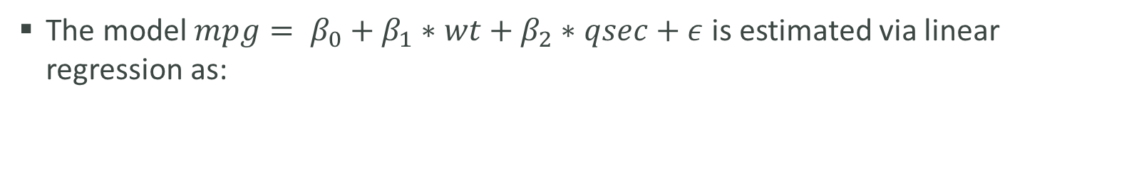
Stochastic Example
The model $mpg= β_{0}+β_{1}∗wt+β_{2}∗qsec+ε$ is estimated via linear regression as:
$$mpg=19.75+(−5.05)∗wt+0.93∗qsec+ε$$
wt | qsec | mpg
1.5 | 14.5 | 19.75 - 5.05*1.5 + 0.93*14.5 = 24.9
3.3 | 17.7 | 19.75 - 5.05*3.3 + 0.93*17.7 = 19.5
5.4 | 22.9 | 19.75 - 5.05*5.4 + 0.93*22.9 = 13.7

